Slide 1
BUSINESS ANALYTICS AND VALUATION ASSIGNMENT
MADE BY - Amartya Som (2022A4PS1511H)

Slide 2
OBJECTIVE
The objective of this assignment is to use different methods of valuation to find out the valuation SRF Ltd. The methods are DCF valuation and Relative valuation.
For the DCF Valuation, we estimate the value of an investment based on its expected future cash flows. For this we perform common sizing, horizontal analysis and prospective analysis.
In the Relative Valuation, we determine the value of an asset by comparing it to similar assets in the market. For this we identify comparable companies and then select a relative multiple to find the valuation of the target company.

Slide 3
DCF VALUATION
For DCF Valuation, first we take data from the balance sheet and the income statement of the company. This data is used to perform common sizing, prospective analysis and vertical analysis.
Common Sizing is used to compare financial statements by standardizing figures as percentages. This makes it easier to analyze trends over time or compare companies of different sizes. For Income Statements, Express each line item as a percentage of total revenue. For Balance Sheets, Express each item as a percentage of total assets or total liabilities/equity.
Horizontal analysis is a financial analysis technique that compares financial statement data across multiple periods to identify trends, growth rates, and patterns over time. It evaluates changes in line items over time (e.g., year-over-year or quarter-over-quarter growth).
Prospective analysis focuses on forecasting a company's future performance by predicting financial metrics such as revenue, costs, profits, and cash flows. This is often used for decision-making in investments, strategic planning, or evaluating a company's valuation.
Finally we project the FCFF and FCFE for the target company with the help of these methods

Slide 4
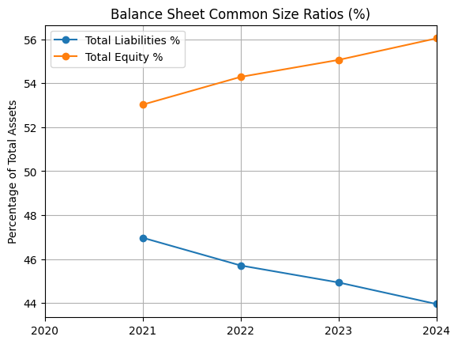
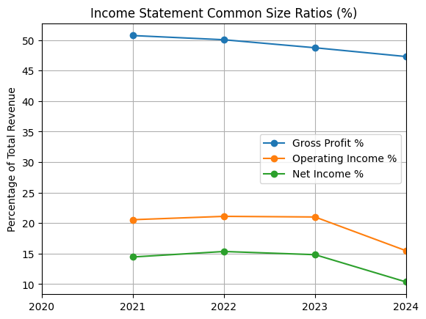
These are the plots for the common sizing ratios taken with respect to the data from the balance sheet and income statement of the company for the last three years.

Slide 5
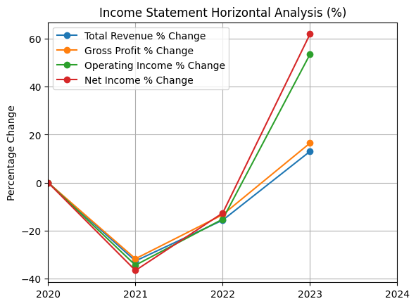
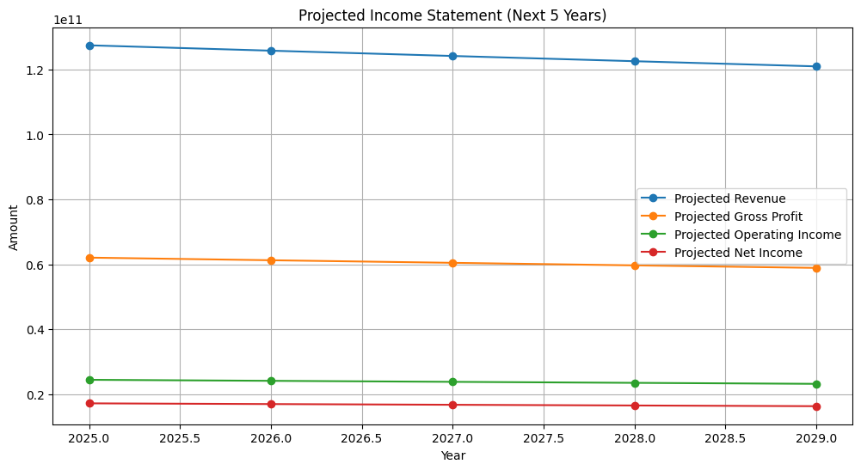
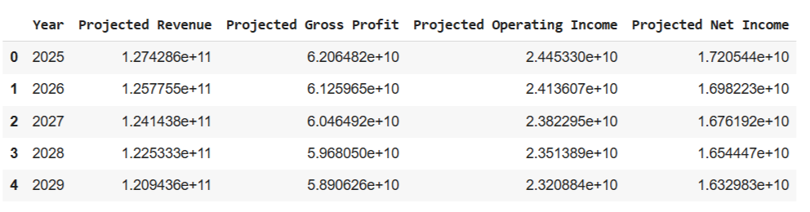
.
These are the plots for the horizontal analysis and the projections for the next 5 years income using this method.

Slide 6
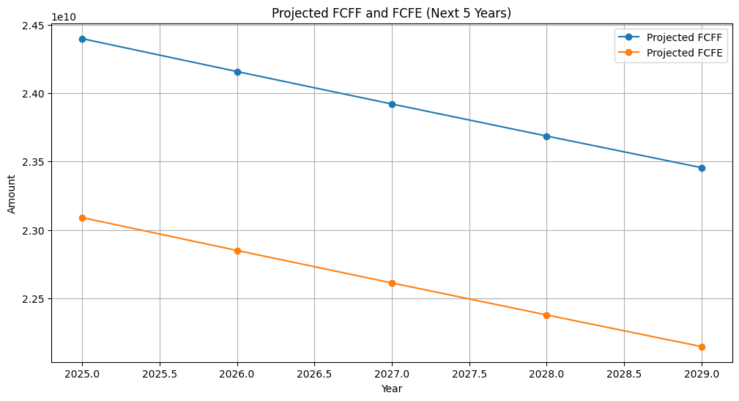
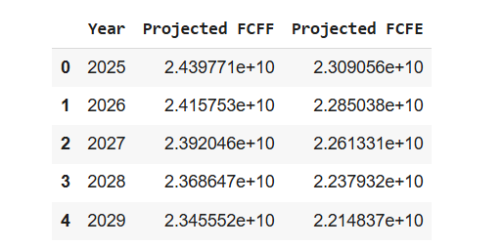
.
As seen in the plot, we have projected the FCFF and FCFE for the target company for the next 5 years.

Slide 7
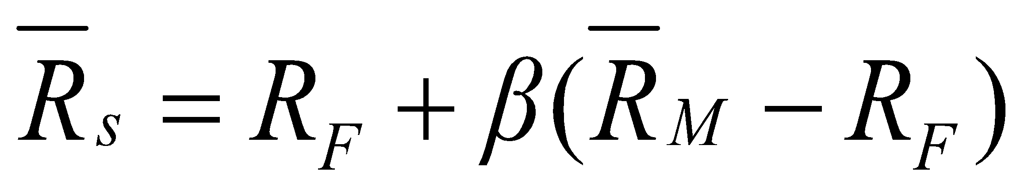
COST OF CAPITAL
The cost of capital is the minimum acceptable rate of return on a capital investment project given its risk and it is the opportunity cost of forgoing other projects of similar risk.
WACC (Weighted Average cost of capital) is the weighted average of the expected after-tax rates of return of the firm’s various sources of invested capital.
Cost of Equity Capital - From the firm’s perspective, the expected return is the Cost of Equity Capital:
We use the CAPM Model to get Beta through regression. This is called the Top Down Approach.
Cost Of Debt - estimate a synthetic rating for the company, and use the synthetic rating to arrive at a default spread and a cost of debt
The rating for a firm can be estimated using the financial characteristics of the firm. In its simplest form, the rating can be estimated from the interest coverage ratio
Interest Coverage Ratio = EBIT / Interest Expenses
Market Value of Equity should include the Market Value of Shares outstanding
We have assumed book value of debt is equal to market value

Slide 8
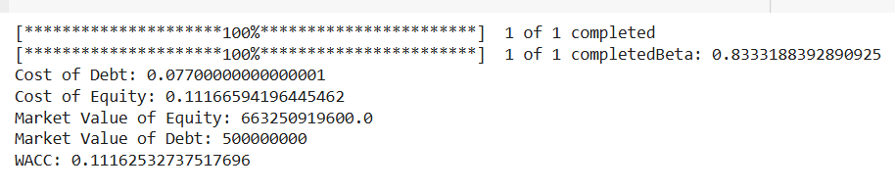
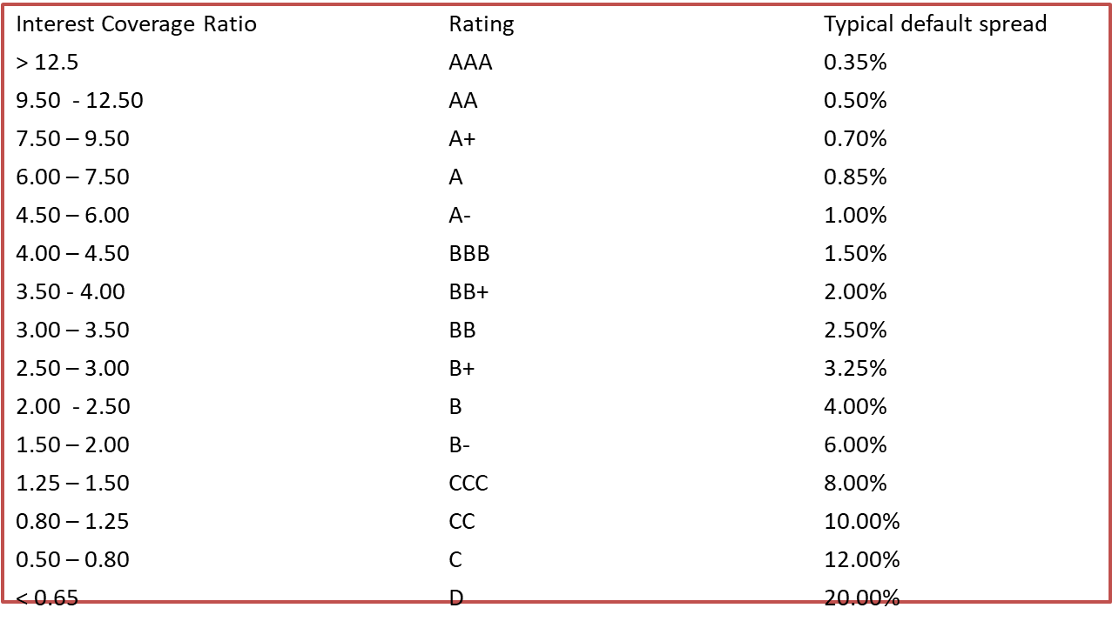

We have calculated Beta for the company using regression.
Finally WACC is calculated using the formula
Tax Rate is taken as 25%

Slide 9
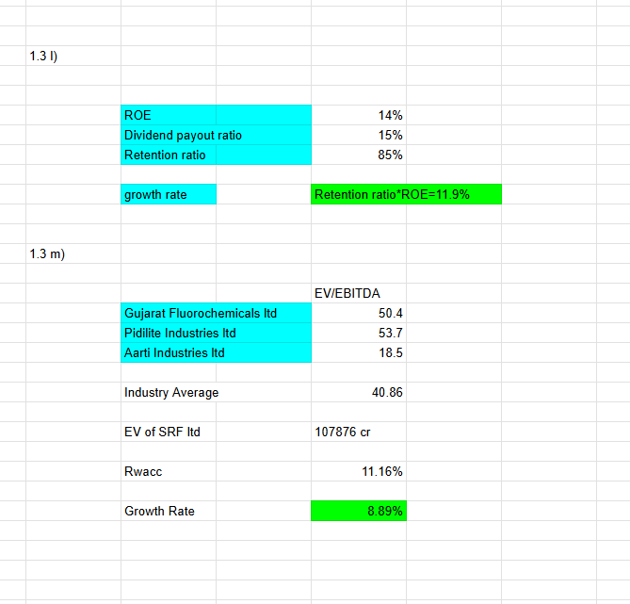
CALCULATION OF GROWTH RATE
To calculate the terminal value growth rate, we can use various approaches based on the scenario and available data.
Earnings next year = Earnings this year + Retained earnings x Return on Retained earnings
g= Retention ratio ×Return on retained earnings (ROE)
The growth using reinvestment rates and ROE capital is calculated here

Slide 10
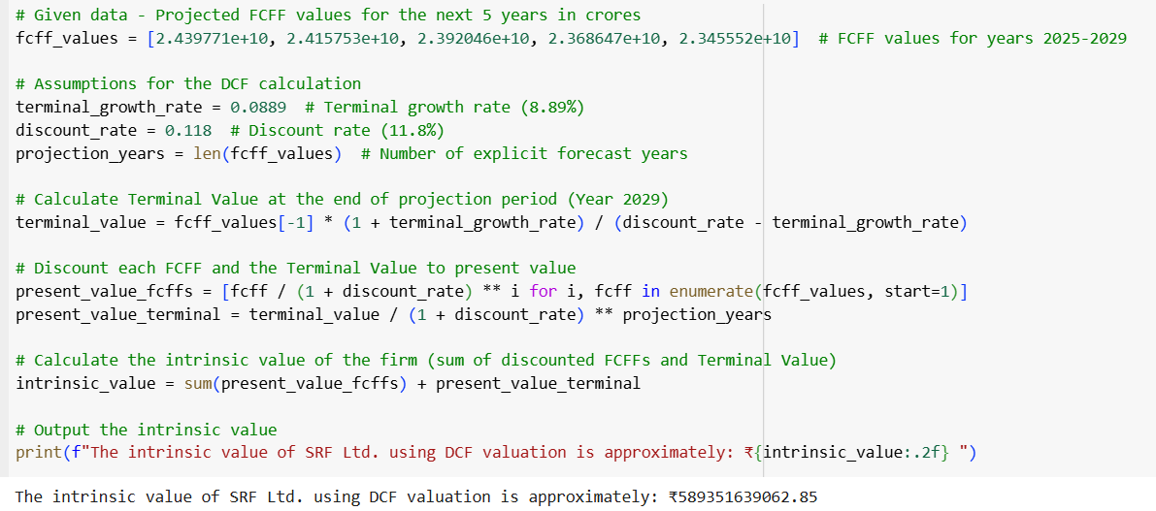
FIRM VALUATION
We have projected the cash flows. Now we need to get the terminal value.
After this we discount each FCFF and the Terminal value to present value
Now we have the FCFFs, Terminal Value, WACC and the growth rate. We can now find the valuation of the target company SRF Ltd.

Slide 11
RELATIVE VALUATION
Relative Valuation is a method of valuing a company by comparing its financial metrics to those of similar companies in the same industry. It is based on the principle that similar companies should have similar valuation.
Our target company is SRF Ltd. And the comparable companies we have taken are Gujarat Fluorochemicals Ltd., Pidilite Industries Ltd. and Aarti Industries Ltd.
The industry multiples we have taken are P/E Ratio and EV/EBITDA Ratio
The price earnings ratio is calculated as the current stock price divided by annual EPS.
P/E Ratio = Price per Share/ EPS
The Enterprise Value Ratio = EV / EBITDA
EBITDA represents a measure of total firm cash flow

Slide 12
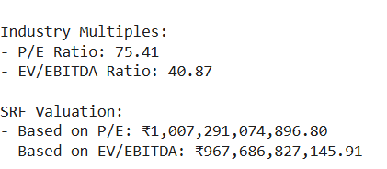
RELATIVE VALUATION
We calculate the average of the industry multiples using data from financial statements of the company.
Then we use the derived average or median multiple and the target company's financial metrics to estimate its value.
Following these steps, we have used the
Industry multiples of P/E Ratio and
EV/EBITDA ratio to find the valuation of
SRF Ltd.

Slide 13

ABOUT THE COMPANY
SRF Limited: Overview
Company and Industry
SRF Limited is a multi-business chemical manufacturing company headquartered in India. It operates in industries such as chemicals, technical textiles, and packaging films. The company plays a pivotal role in India's chemical industry, which accounts for 4% of the global market, with growing demand driven by sectors like pharmaceuticals, agriculture, and manufacturing
Products and Services
SRF's operations are organized into several business segments:
Chemicals Business (CB): Produces refrigerant gases, specialty chemicals, and industrial chemicals.
Technical Textiles Business (TTB): Focuses on products like nylon and polyester tire cord fabrics, used mainly in the automotive industry.
Packaging Film Business (PFB): Produces polyester and polypropylene films.
Others: Includes laminated and coated fabrics​

Slide 14
INSIGHTS ABOUT THE COMPANY
SRF operates in industries poised for growth. The global chemical and packaging markets are expanding due to factors such as increased urbanization, rising incomes, and demand for non-Chinese suppliers. SRF Ltd. are leveraging this shift with strategic investments in capacity and innovation.
SRF’s well-diversified portfolio, global reach, and strategic investments position it to capitalize on favorable industry trends and increased demand across multiple sectors. The company's financial prudence, as reflected in its decreasing debt-equity ratio and improving return ratios enhances its resilience and growth outlook.

Slide 15
REFERENCES
https://finance.yahoo.com/quote/SRF.NS/
https://www.screener.in/company/SRF/consolidated/
THANK YOU

